Slide 1
Effects of static negative middle-ear pressure on wideband acoustic immittance
Sarah Robinson, Suzanne Thompson, Jont Allen

Slide 2
Negative middle ear pressure (NMEP)
NMEP can affect other acoustic measurements of hearing (e.g. otoacoustic emissions)
Static NMEP is very common
It is typically due to Eustachian tube dysfunction
It often occurs concurrently with middle ear fluid or infection
Middle ear pressure in normal ears varies often
It is slightly negative during waking hours
A NMEP smaller than -100 [daPa] is considered ‘normal’
1

Slide 3
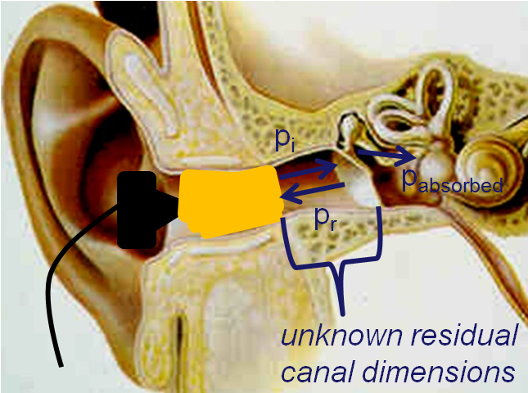
Wideband acoustic immittance (WAI)
WAI refers to a set of quantities, including the admittance, impedance, reflectance, absorbance, etc.
Many applications consider the power reflectance and absorbance (≈ independent of ear canal length)
2

Slide 4
Methods
WAI was measured with ambient ear canal pressure
Subjects with normal middle ears induced negative middle ear pressure (NMEP) via the Toynbee maneuver
Middle ear pressure was assessed separately via tympanometry
Middle ear pressure = tympanic peak pressure (TPP)
8 trials at ambient middle ear pressure (AMEP)
were alternated with 8 trials at NMEP
Subjects were able to induce consistent NMEPs
We focus on individual ears (lots of retest data)
Tympanogram
@ 226 [Hz]
TM Compliance
-400
0
200
TPP
Ear Canal Pressure [daPa]
3

Slide 5
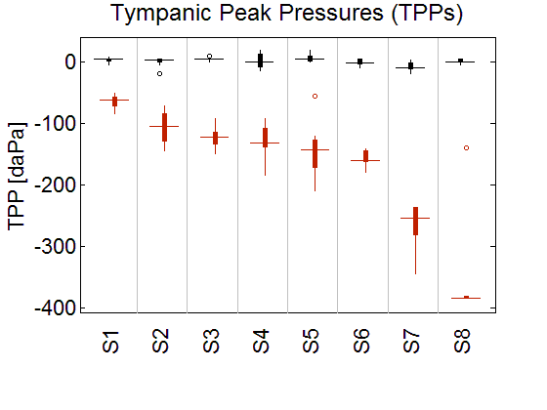
Methods
AMEP
NMEP
4

Slide 6
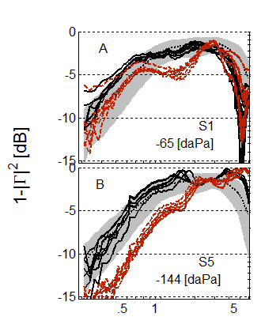
WAI Results: Power Absorbance
AMEP
NMEP
5

Slide 7
WAI Results: Power Absorbance
AMEP
NMEP
5

Slide 8
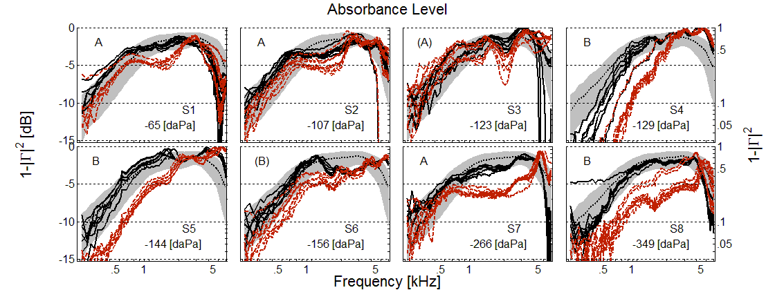
WAI Results: Power Absorbance
AMEP
Wideband changes in power absorbance due to NMEP…
vary in both magnitude and frequency range
do not appear to have a simple dependence on pressure
NMEP
6

Slide 9
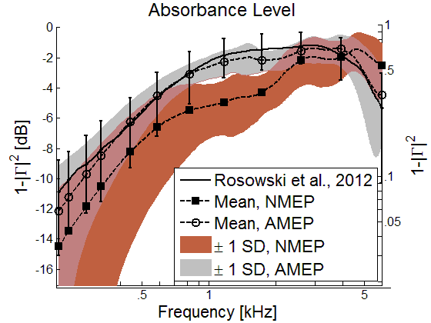
WAI Results: Power Absorbance
7

Slide 10
WAI Results: Power Absorbance
7

Slide 11
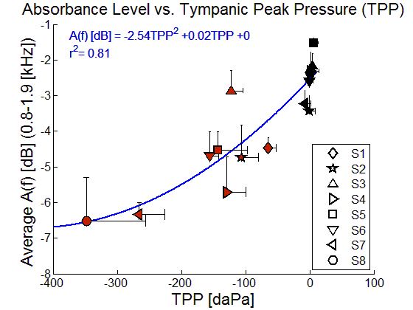
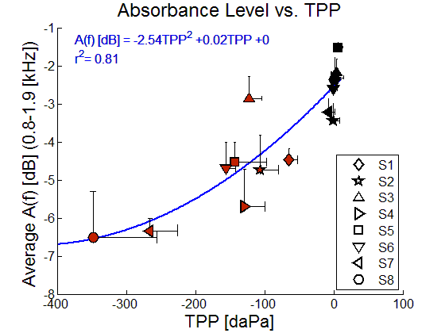
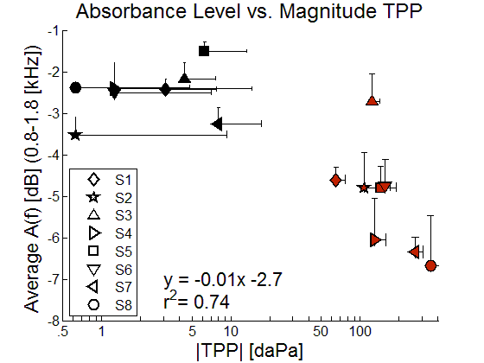
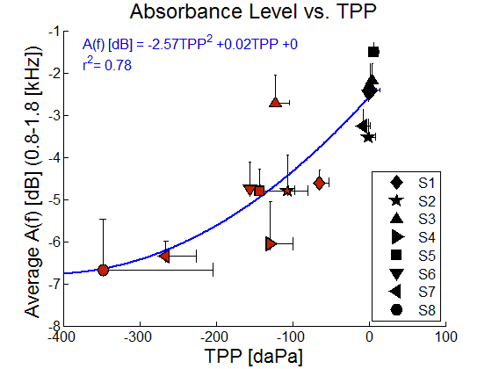
Dependence on static ME pressure
AMEP
NMEP
8

Slide 12
WAI at the tympanic membrane (TM-WAI)
The unknown residual ear canal (REC) delay may removed from the reflectance phase (Robinson et al., 2013)
Using our methods, Γ_{rec}(f) may account for a lossless REC of varying area
C_{tm}
L_{rec}
r_{c}
Γ(f) = Γ_{rec}(f) x Γ_{tm}(f)
|Γ(f)| = 1 x |Γ_{tm}(f)|
9

Slide 13
WAI at the tympanic membrane (TM-WAI)
At low frequencies, the REC volume is approximated by a compliance
A resistor is necessary to match the transmission lines of the middle ear and cochlea (Zwislocki 1962, Lynch 1982)
C_{tm}
L_{rec}
C_{tm}
r_{c}
C_{rec}
r_{c}
Γ(f) = Γ_{rec}(f) x Γ_{tm}(f)
|Γ(f)| = 1 x |Γ_{tm}(f)|
Low frequency approximation
10

Slide 14
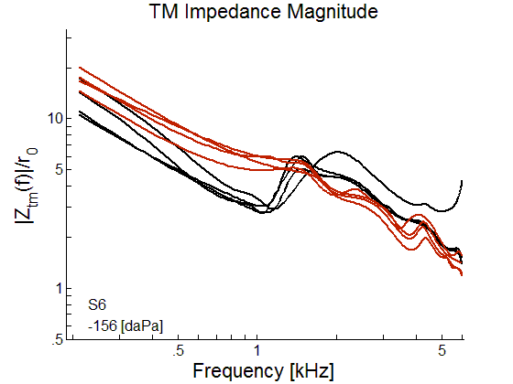
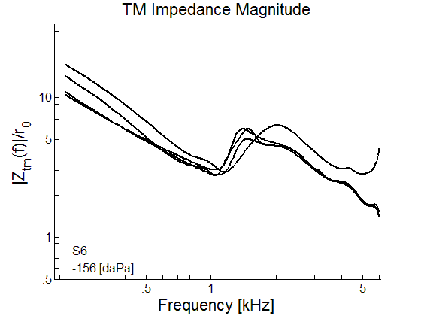
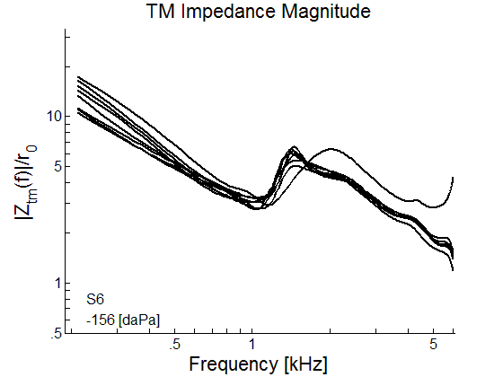
TM-WAI: Impedance
11

Slide 15
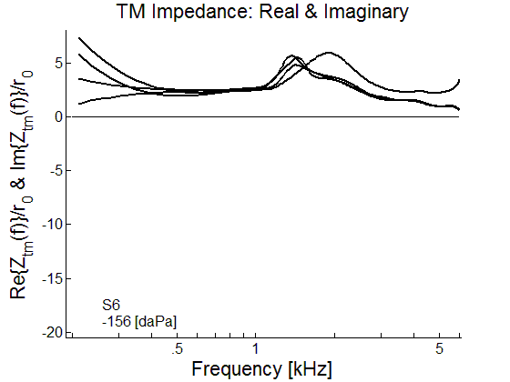
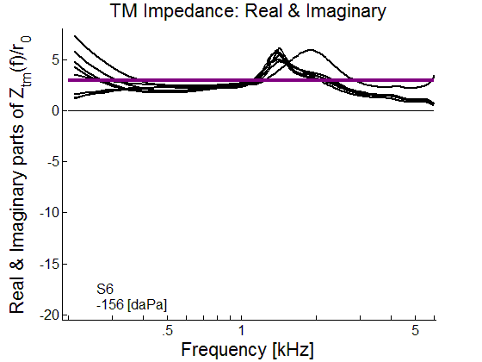
TM-WAI: Impedance
r_{c}
C_{tm}
Real
Imaginary
C_{rec}
r_{c}
12

Slide 16
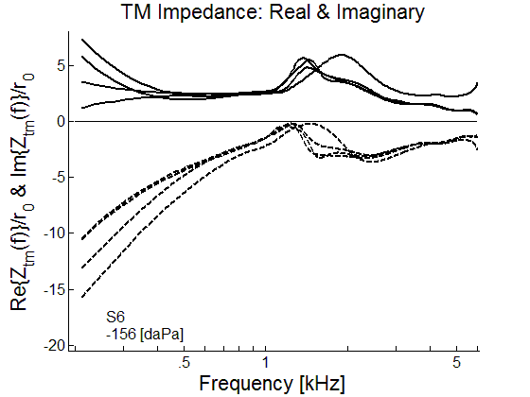
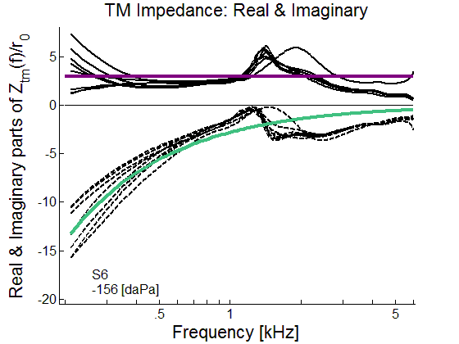
TM-WAI: Impedance
r_{c}
-1/2πfC_{tm}
C_{tm}
Real
Imaginary
C_{rec}
r_{c}
12

Slide 17
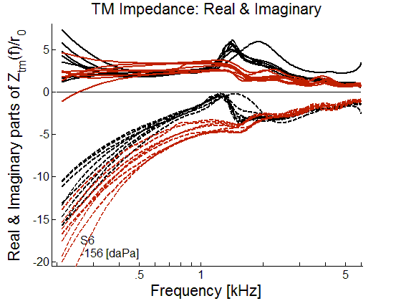
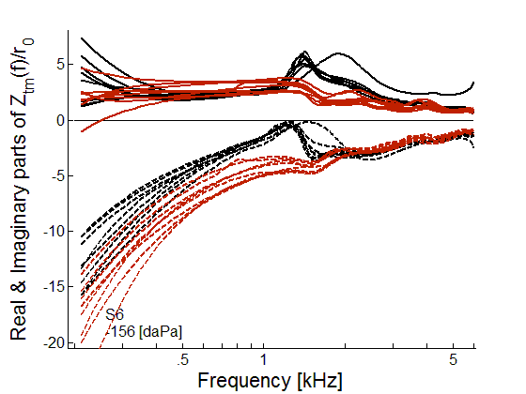
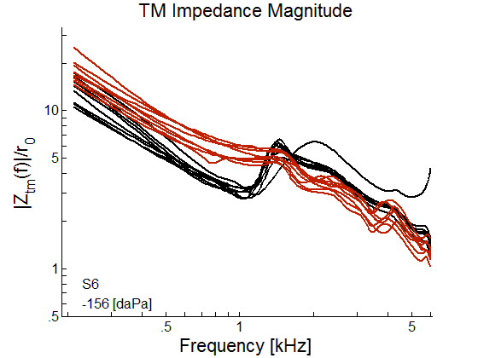
TM-WAI: Impedance
NMEP = -156 [daPa]
NMEP = -156 [daPa]
Real
Imaginary
13

Slide 18
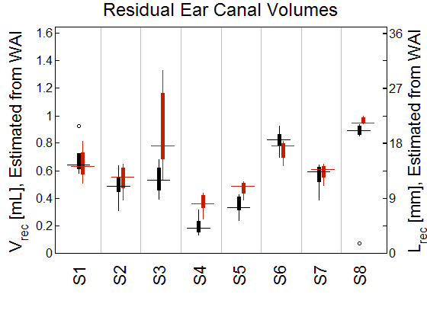
Residual ear canal (REC) volume
The REC volume does not depend on NMEP
C_{tm}
C_{rec}
r_{c}
AMEP
NMEP
Volume (C_{rec}) [mL]
*
*
*
Growing NMEP
14

Slide 19
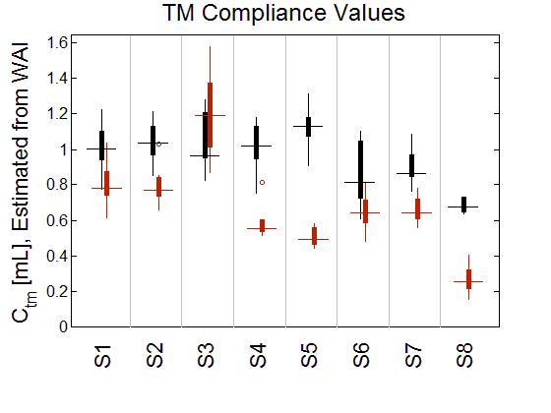
TM Compliance
NMEP
The REC volume does not depend on NMEP
The TM compliance does depend on NMEP
C_{tm}
C_{rec}
r_{c}
AMEP
NMEP
Volume (C_{rec}) [mL]
C _{tm}[mL]
*
*
*
*
*
*
*
*
*
*
*
*
*
Growing NMEP
Growing NMEP
14

Slide 20
Mechanisms for NMEP-dependent change
NMEP decreases the compliance C_{tm} at the tympanic membrane (TM)
The TM is retracted (Shaver & Sun 2013, Voss et al. 2012)
Often assumed to be the main source of compliance change
The TM acts as a delay line in normal ears (Puria & Allen 1998)
Nonlinear compliance is likely related to middle ear ligaments
WAI changes due to NMEP resemble stiffened annular ligament (AL) changes (e.g. acoustic stapedius reflex, Feeney & Keefe 1999)
The tensor tympani (TT) may cause similar WAI changes to the AL (Møller 1983, Bance et al. 2013, Aron et al. 2015), but little data exists to quantify this in human ears
15

Slide 21
Conclusions
We can directly estimate the complex WAI at the TM
The residual ear canal delay (independent of NMEP) is removed
WAI changes due to NMEP vary in magnitude and frequency range
The most significant decrease in power absorbance level occurs from 0.8-1.9 [kHz]
TPP is a significant but imperfect predictor of WAI change
The aggregate middle ear compliance C_{tm} decreases due to NMEP
WAI change is well described by a simple model
This does not require selective averaging of frequency bands
16

Slide 22
Clinical Implications
WAI is not a strong predictor of NMEP level (typically measured by TPP)
However, we can evaluate Eustachian tube function using WAI
WAI provides frequency-specific information about middle ear transmission that tympanometry does not
Changes in WAI due to NMEP are generally too small to impact hearing thresholds, however…
Can affect measurement of otoacoustic emissions (OAEs), due to forward and reverse transmission through the middle ear
We predict that frequency-specific changes in DPOAEs/TEOAEs are related to changes in WAI
17

Slide 23
Thanks for listening!
Contact: jontalle@illinois.edu, srrobin2@illinois.edu
Aron, M., Floyd, D., Bance, M. (2015). Voluntary eardrum movement: A marker for tensor tympani contraction? Otol Neurotol, 36(2), 373–381.
Bance, M. , Makki, F. M., Garland, P., et al. (2013). Effects of tensor tympani muscle contraction on the middle ear and markers of a contracted muscle. Laryngoscope, 123(4), 1021–1027.
Feeney, M. P. & Keefe, D. H. (1999). Acoustic reflex detection using wide-band acoustic reflectance, admittance, and power measurements. J Speech Lang Hear Res, 42(5), 1029–1041.
Lynch III, T. J., Nedzelnitsky, V., Peake, W. T. (1982). Input impedance of the cochlea in cat. J Acoust Soc Am, 72(1), 108–130.
Møller, A. R. (1983). Auditory Physiology. Academic Press, Inc., New York, New York.
Puria, S. & Allen, J. B. (1998). Measurements and model of the cat middle ear: evidence of tympanic membrane acoustic delay. J Acoust Soc Am, 104, 3463–3481.
Robinson, S. R., Nguyen, C. T., Allen, J. B. (2013). Characterizing the ear canal acoustic impedance and reflectance by pole-zero fitting. Hear Res, 301, 168–182.
Rosowski, J. J., Nakajima, H. H., Hamade, M. A., et al. (2012). Ear-canal reflectance, umbo velocity, and tympanometry in normal- hearing adults. Ear Hear, 33(1), 19–34.
Shaver, M. D. & Sun, X. M. (2013). Wideband energy reflectance measurements: effects of negative middle ear pressure and application of a pressure compensation procedure. J Acoust Soc Am, 134(1), 332–341.
Sun, X. M. & Shaver, M. D. (2009). Effects of negative middle ear pressure on distortion product otoacoustic emissions and application of a compensation procedure in humans. Ear Hear, 30(2), 191–202.
Voss, S. E. , Merchant, G. R., Horton, N. J. (2012). Effects of middle-ear disorders on power reflectance measured in cadaveric ear canals. Ear Hear, 33(2), 195–208.
Zwislocki, J. (1962). Analysis of the middle-ear function. Part I: Input impedance. J Acoust Soc Am, 34, 1514–1523.

